Slide 1



PRESENTATION ON
FINANCIAL DATA ANALYSIS
Name: M Manideep
Batch: 456
Innomatics Research Labs, Dilsukhnagar

Slide 2

AGENDA:
Introduction
Objective
Exploratory Insights
Income Statement Analysis
Cash Flow Statement Analysis
Balance Sheet &Growth Analysis
Combined Insights
Conclusion

Slide 3
Business Problem
Financial data from income statements, balance sheets, and cash flow statements exists across multiple companies and time periods, making it difficult to gain a quick and unified understanding of financial performance.
Decision-makers struggle to compare revenue growth, profitability, liquidity, and financial risk without a centralized, visual, and interactive analysis.
The lack of clear insights makes it challenging to identify top-performing companies, detect declining financial health, and support timely, data-driven business decisions.

Slide 4

Introduction:
Analyze the company’s overall financial condition using Income Statement, Balance Sheet, and Cash Flow data.
Evaluate profitability, expenses, assets, liabilities, and cash movements to identify strengths and weaknesses.
Examine financial trends and key performance indicators to understand stability and growth.
Support better decision-making by providing a clear view of current performance and future financial direction.

Slide 5

Objective:
Understand the company’s financial condition by analyzing profits, cash flow, and debt levels.
Identify key factors driving financial changes and highlight potential financial risks.
Support effective planning and informed decision-making for the company’s future.

Slide 6
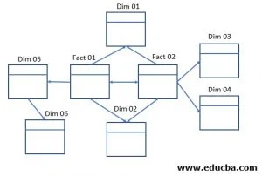
Galaxy Schema Description
A Galaxy Schema uses multiple fact tables connected to shared dimension tables.
It is used when different business processes share common dimensions such as date or company.
This schema supports complex reporting by improving flexibility and performance for large financial datasets.
One-to-Many (1:*) — Most Common
One table has unique values (Dimension table).
The other has repeated values (Fact table).
Example: Date Table (1) → Sales Table (*)

Slide 7
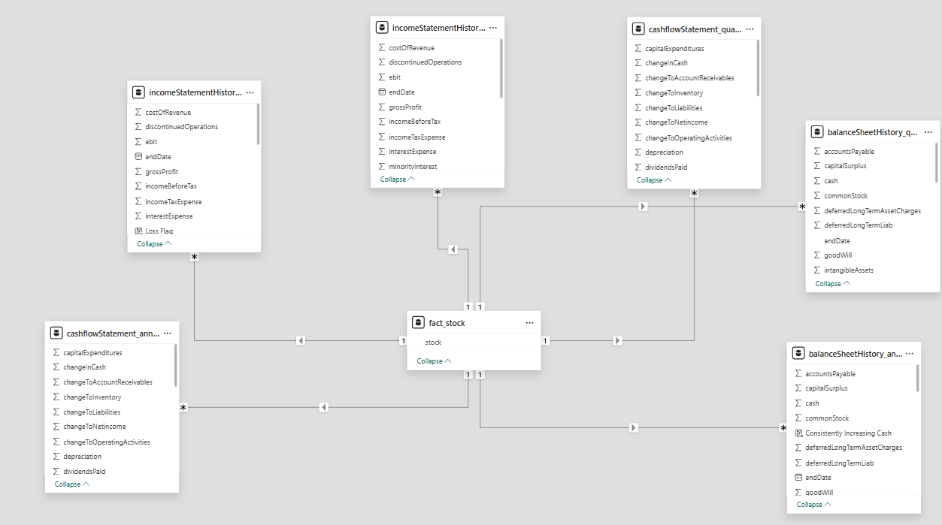
DATA MODELLING

Slide 8
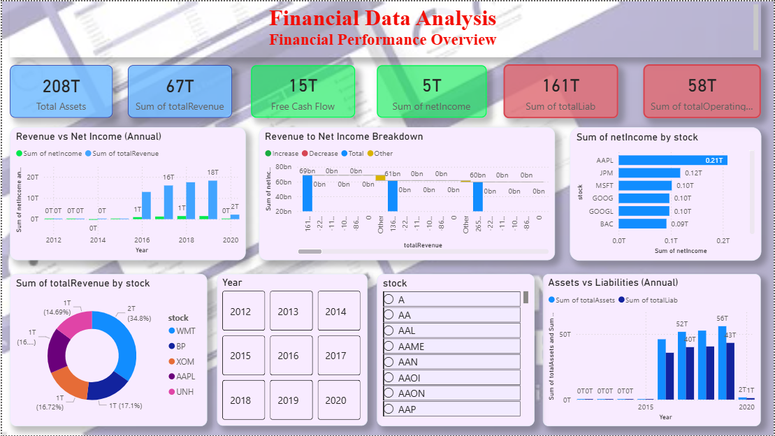

Slide 9
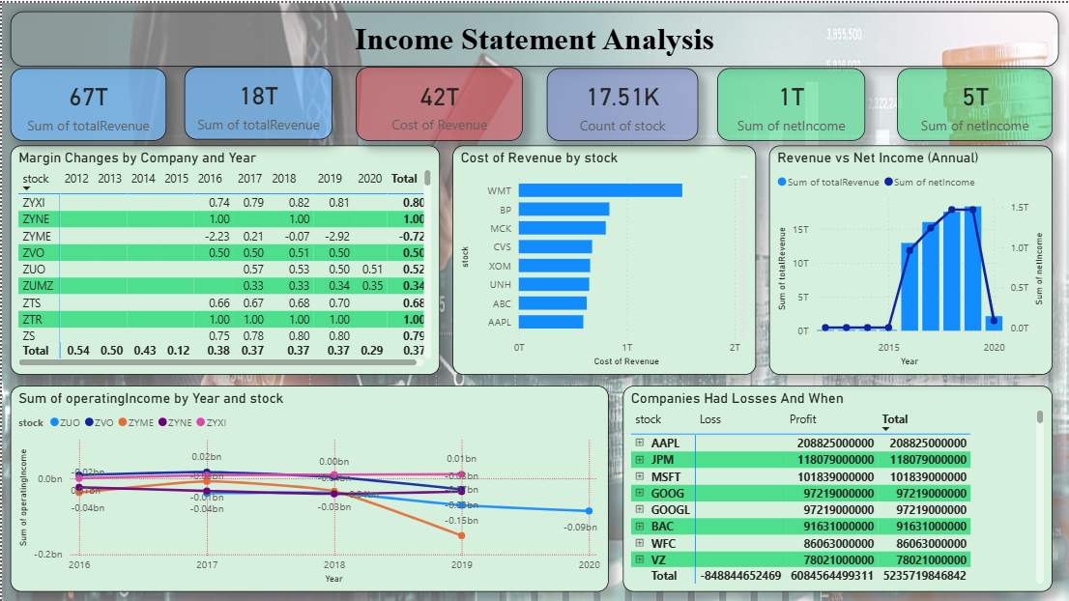

Slide 10
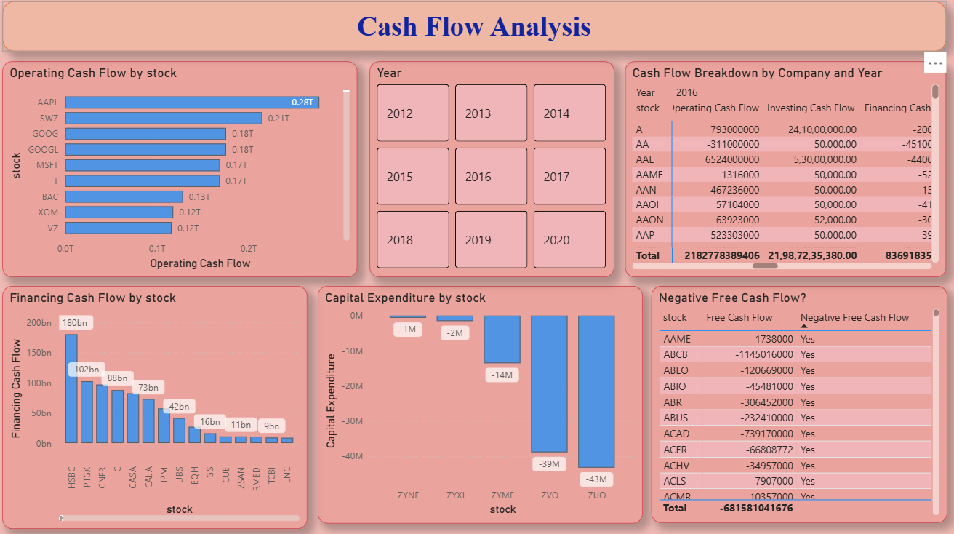

Slide 11
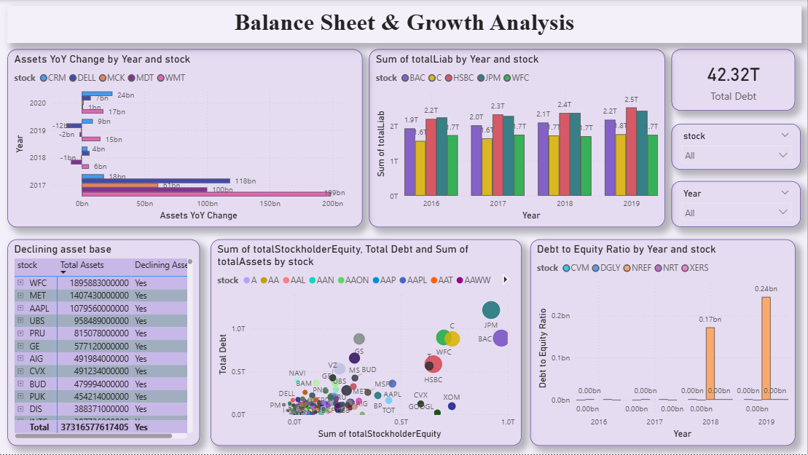

Slide 12
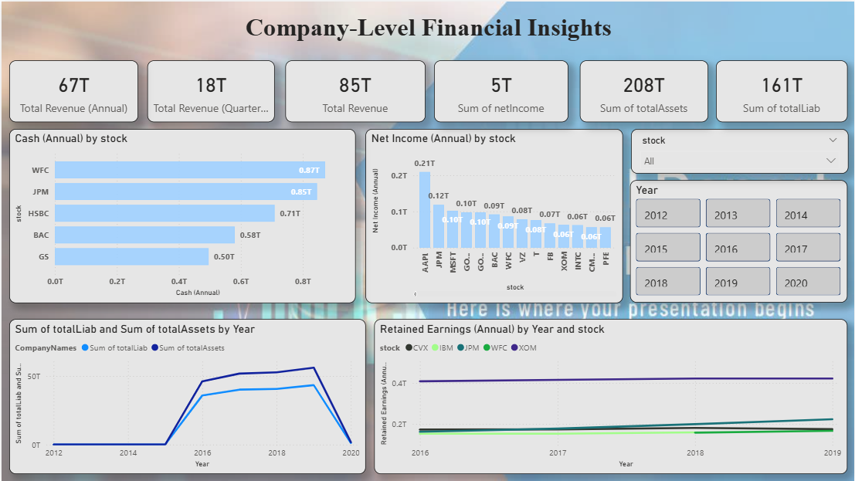

Slide 13
Key Insight :
Balance Sheet Analysis
Asset growth compared with liabilities highlights overall financial strength and stability.
Rising debt or high debt-to-equity ratios indicate increased financial risk and leverage pressure.
Cash Flow Analysis
Strong operating cash flow indicates healthy liquidity and sustainable operations.
Negative free cash flow highlights potential financial risk due to high spending or weak cash generation.
Income Statement Analysis
Revenue growth does not always translate into higher profits due to rising costs and expenses.
Companies with stable operating income show stronger profitability and better cost control.

Slide 14
Conclusion:
The company shows mixed financial performance, with some stocks having strong revenue growth while others face declining income and increasing liabilities.
Cash flow trends indicate high capital spending and unstable operating cash flow for many firms, affecting long-term stability.
Total assets generally grew across years, but liabilities also increased, reducing the overall financial cushion.

Slide 15
Recommendations :
Improve operating efficiency to strengthen cash flow.
Control capital spending to avoid cash pressure.
Maintain a healthy debt-to-equity balance.
Diversify revenue to reduce risk.
Monitor financial KPIs regularly for early risk detection.

Slide 16


Slide 17


